Slide 1

Statistics
MTH 564 – Mathematical Modeling

Slide 2

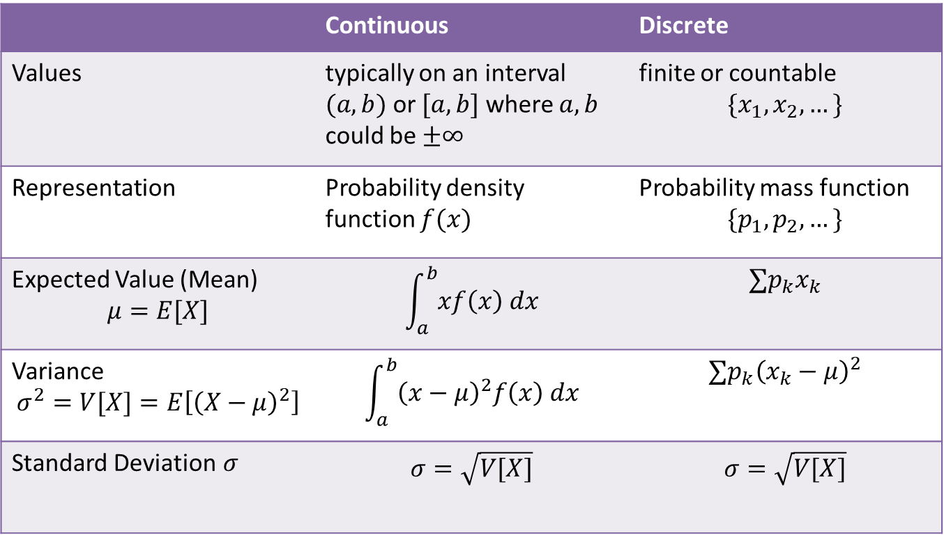
Continuous Probability Models
 | Continuous | Discrete
Values | typically on an interval $(a,b)$ or $[a,b]$ where $a, b$ could be $±∞$ | finite or countable $$\{x_{1},x_{2}, …\}$$
Representation | Probability density function $f(x)$ | Probability mass function $$\{p_{1},p_{2},…\}$$
Expected Value (Mean) $$μ=E[X]$$ | $$\int_{a}^{b}{xf\left(x\right) dx}$$ | $$∑p_{k}x_{k}$$
Variance $$σ^{2}=V[X]=E\left[{\left(X−μ\right)}^{2}\right]$$ | $$\int_{a}^{b}{{\left(x−μ\right)}^{2}f\left(x\right) dx}$$ | $$∑p_{k}{\left(x_{k}−μ\right)}^{2}$$
Standard Deviation$σ$ | $$σ=\sqrt{V[X]}$$ | $$σ=\sqrt{V[X]}$$

Slide 3
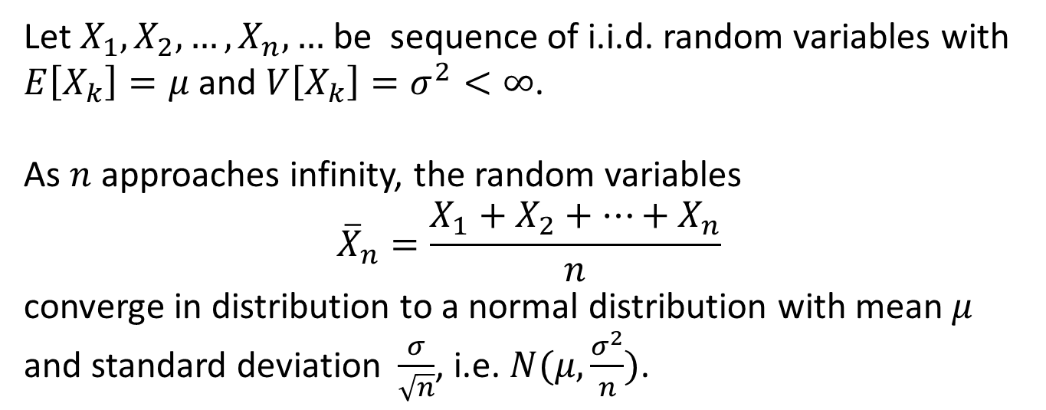
Central Limit Theorem
Let $X_{1}, X_{2}, …, X_{n}, …$ be sequence of i.i.d. random variables with $E\left[X_{k}\right]=μ$ and $V\left[X_{k}\right]=σ^{2}<∞$.
As $n$ approaches infinity, the random variables
$${\overline{X}}_{n}=\frac{X_{1}+X_{2}+…+X_{n}}{n}$$
converge in distribution to a normal distribution with mean $μ$ and standard deviation $\frac{σ}{\sqrt{n}}$, i.e. $N(μ,\frac{σ^{2}}{n})$.

Slide 4
Problem
An emergency 911 service in a local community received an average of 171 calls per month for house fires over the past year. Based on this data, the rate of house fire emergencies was estimated at 171 per month. The next month only 153 calls were received. Does this indicate an actual reduction in the rate of house fires or is it simply a random fluctuation?

Slide 5
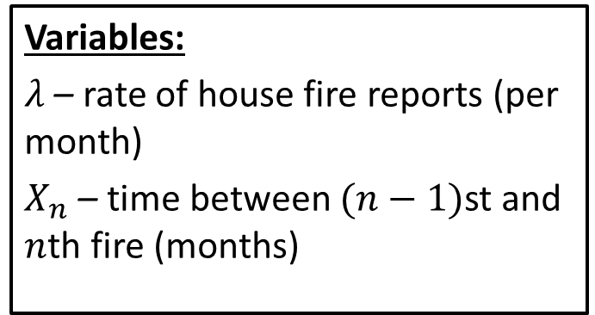
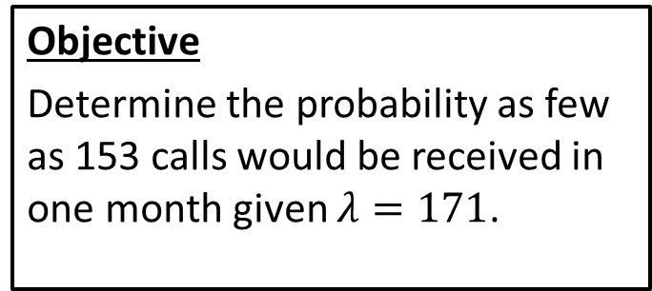
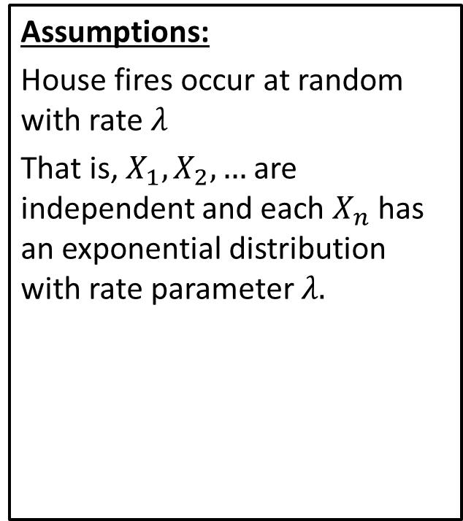
Step 1: Frame the problem
Variables:
$λ$ – rate of house fire reports (per month)
$X_{n}$ – time between $(n−1)$st and $n$th fire (months)
Assumptions:
House fires occur at random with rate $λ$
That is, $X_{1}, X_{2}, …$ are independent and each $X_{n}$ has an exponential distribution with rate parameter $λ.$
Objective
Determine the probability as few as 153 calls would be received in one month given $λ=171$.

Slide 6
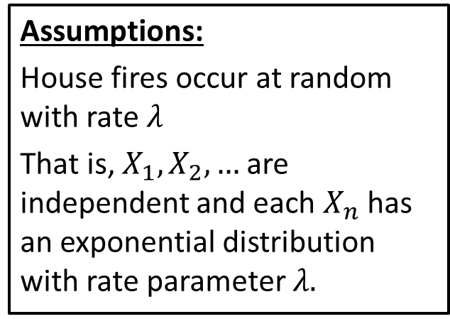
Step 2: Select the modeling approach
Variables:
$λ$ – rate of house fire reports (per month)
$X_{n}$ – time between $(n−1)$st and $n$th fire (months)
Assumptions:
House fires occur at random with rate $λ$
That is, $X_{1}, X_{2}, …$ are independent and each $X_{n}$ has an exponential distribution with rate parameter $λ.$
Objective
Determine the probability as few as 153 calls would be received in one month given $λ=171$.
Approach
We model this as a statistical inference problem.

Slide 7
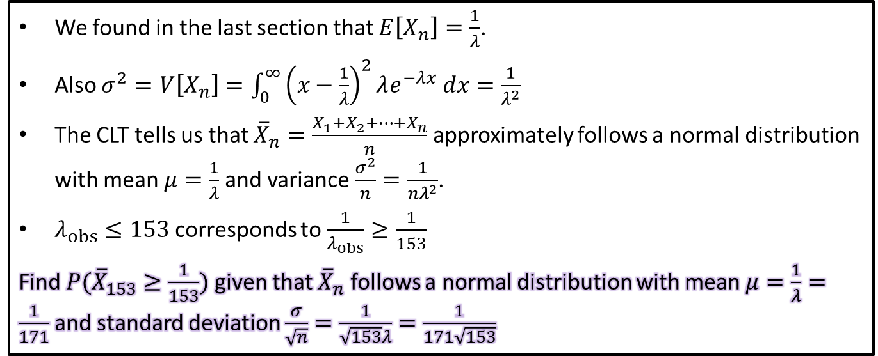
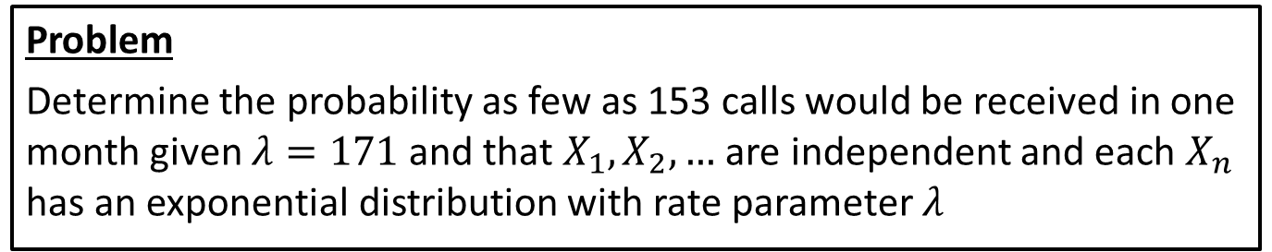
Step 3: Formulate the model
Problem
Determine the probability as few as 153 calls would be received in one month given $λ=171$ and that $X_{1}, X_{2}, …$ are independent and each $X_{n}$ has an exponential distribution with rate parameter $λ$
We found in the last section that $E\left[X_{n}\right]=\frac{1}{λ}$.
Also $σ^{2}=V\left[X_{n}\right]=\int_{0}^{∞}{{\left(x−\frac{1}{λ}\right)}^{2}λe^{−λx} dx}=\frac{1}{λ^{2}}$
The CLT tells us that ${\overline{X}}_{n}=\frac{X_{1}+X_{2}+…+X_{n}}{n}$ approximately follows a normal distribution with mean $μ=\frac{1}{λ}$and variance $\frac{σ^{2}}{n}=\frac{1}{{nλ}^{2}}$.
$λ_{obs}≤153$ corresponds to $\frac{1}{λ_{obs}}≥\frac{1}{153}$
Find $P({\overline{X}}_{153}≥\frac{1}{153})$ given that ${\overline{X}}_{n}$ follows a normal distribution with mean $μ=\frac{1}{λ}=\frac{1}{171}$and standard deviation $\frac{σ}{\sqrt{n}}=\frac{1}{\sqrt{153}λ}=\frac{1}{171\sqrt{153}}$

Slide 8
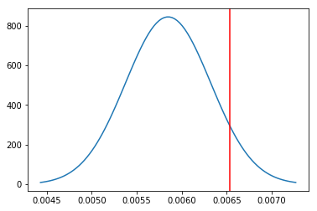
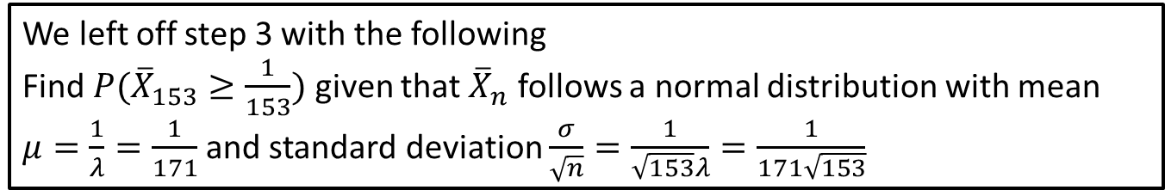
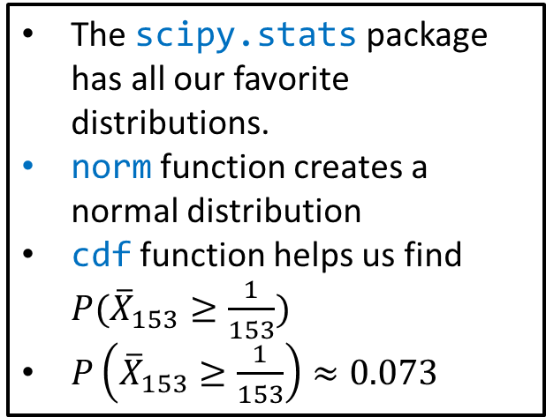
Step 4: Solve the Problem
We left off step 3 with the following
Find $P({\overline{X}}_{153}≥\frac{1}{153})$ given that ${\overline{X}}_{n}$ follows a normal distribution with mean $μ=\frac{1}{λ}=\frac{1}{171}$and standard deviation $\frac{σ}{\sqrt{n}}=\frac{1}{\sqrt{153}λ}=\frac{1}{171\sqrt{153}}$
The scipy.stats package has all our favorite distributions.
norm function creates a normal distribution
cdf function helps us find $P({\overline{X}}_{153}≥\frac{1}{153})$
$P\left({\overline{X}}_{153}≥\frac{1}{153}\right)≈0.073$
Notes:
See python file section1-1pig.py

Slide 9
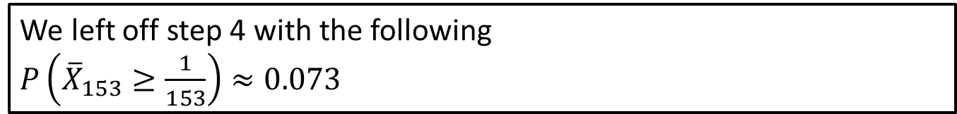
Step 5: Answer the question
We left off step 4 with the following
$P\left({\overline{X}}_{153}≥\frac{1}{153}\right)≈0.073$
Based on the value above we determine if the data from this month is statistically significant. That is, can we conclude that the rate of house fires has decreased?
The agreed upon standard for statistically significance is the 5% level. That is, if you observe an event with rarity of less than 5% then we have evidence “beyond a reasonable doubt”.
There is insufficient evidence to conclude that the rate of house fire emergency calls has declined. The variation in the observed number of calls may be the result of normal random variation. If the observed number of calls continues to be this low, we will reassess the situation.
Notes:
See python file section1-1pig.py

Slide 10
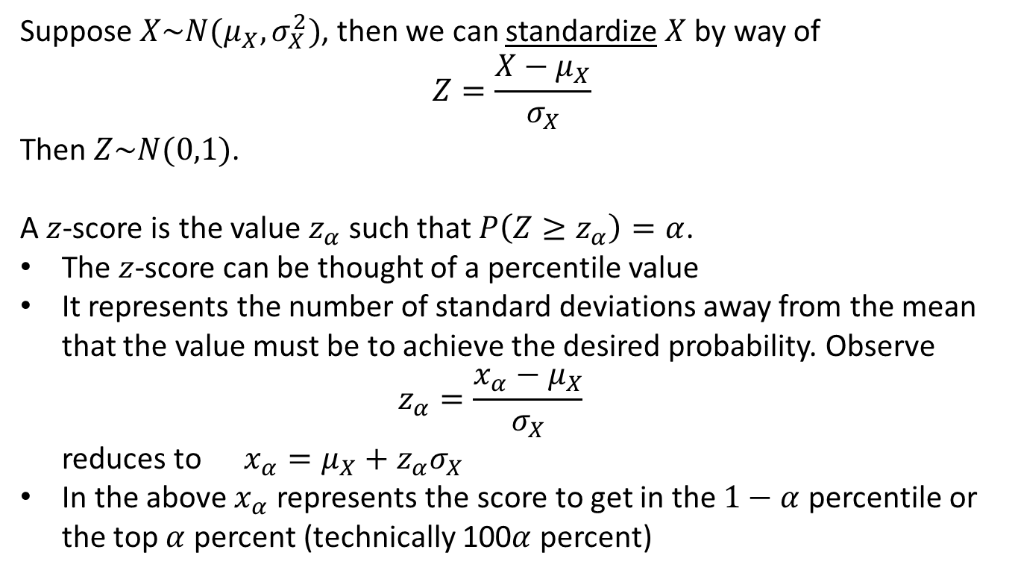
Normal Distribution Properties
Suppose $X\sim N(μ_{X}, σ_{X}^{2})$, then we can standardize $X$ by way of
$$Z=\frac{X−μ_{X}}{σ_{X}}$$
Then $Z\sim N(0,1)$.
A $z$-score is the value $z_{α}$ such that $P\left(Z≥z_{α}\right)=α$.
The $z$-score can be thought of a percentile value
It represents the number of standard deviations away from the mean that the value must be to achieve the desired probability. Observe $z_{α}=\frac{x_{α}−μ_{X}}{σ_{X}}$ reduces to $x_{α}=μ_{X}+z_{α}σ_{X}$
In the above $x_{α}$ represents the score to get in the $1−α$ percentile or the top $α$ percent (technically 100$α$ percent)

Slide 11
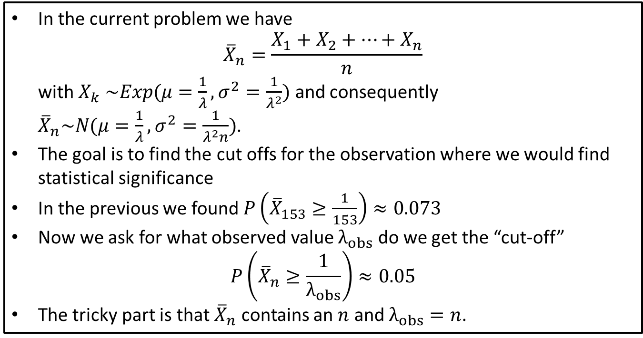
Sensitivity Analysis: 153 obs.
In the current problem we have ${\overline{X}}_{n}=\frac{X_{1}+X_{2}+…+X_{n}}{n}$ with $X_{k} \sim Exp(μ=\frac{1}{λ},σ^{2}=\frac{1}{λ^{2}})$ and consequently ${\overline{X}}_{n}\sim N(μ=\frac{1}{λ},σ^{2}=\frac{1}{λ^{2}n})$.
The goal is to find the cut offs for the observation where we would find statistical significance
In the previous we found $P\left({\overline{X}}_{153}≥\frac{1}{153}\right)≈0.073$
Now we ask for what observed value $λ_{obs}$ do we get the “cut-off” $P\left({\overline{X}}_{n}≥\frac{1}{λ_{obs}}\right)≈0.05$
The tricky part is that ${\overline{X}}_{n}$ contains an $n$ and $λ_{obs}=n$.
Notes:
See python file section1-1pig.py

Slide 12
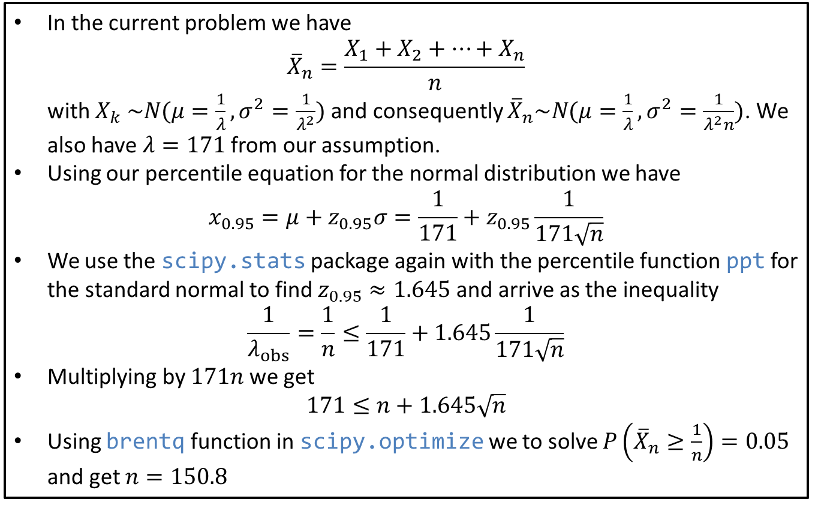
Sensitivity Analysis: 153 obs.
In the current problem we have ${\overline{X}}_{n}=\frac{X_{1}+X_{2}+…+X_{n}}{n}$ with $X_{k} \sim N(μ=\frac{1}{λ},σ^{2}=\frac{1}{λ^{2}})$ and consequently ${\overline{X}}_{n}\sim N(μ=\frac{1}{λ},σ^{2}=\frac{1}{λ^{2}n})$. We also have $λ=171$ from our assumption.
Using our percentile equation for the normal distribution we have $x_{0.95}=μ+z_{0.95}σ=\frac{1}{171}+z_{0.95}\frac{1}{171\sqrt{n}}$
We use the scipy.stats package again with the percentile function ppt for the standard normal to find $z_{0.95}≈1.645$ and arrive as the inequality
$$\frac{1}{λ_{obs}}=\frac{1}{n}≤\frac{1}{171}+1.645\frac{1}{171\sqrt{n}}$$
Multiplying by $171n$ we get $171≤n+1.645\sqrt{n}$
Using brentq function in scipy.optimize we to solve $P\left({\overline{X}}_{n}≥\frac{1}{n}\right)=0.05$ and get $n=150.8$
Notes:
See python file section1-1pig.py

Slide 13
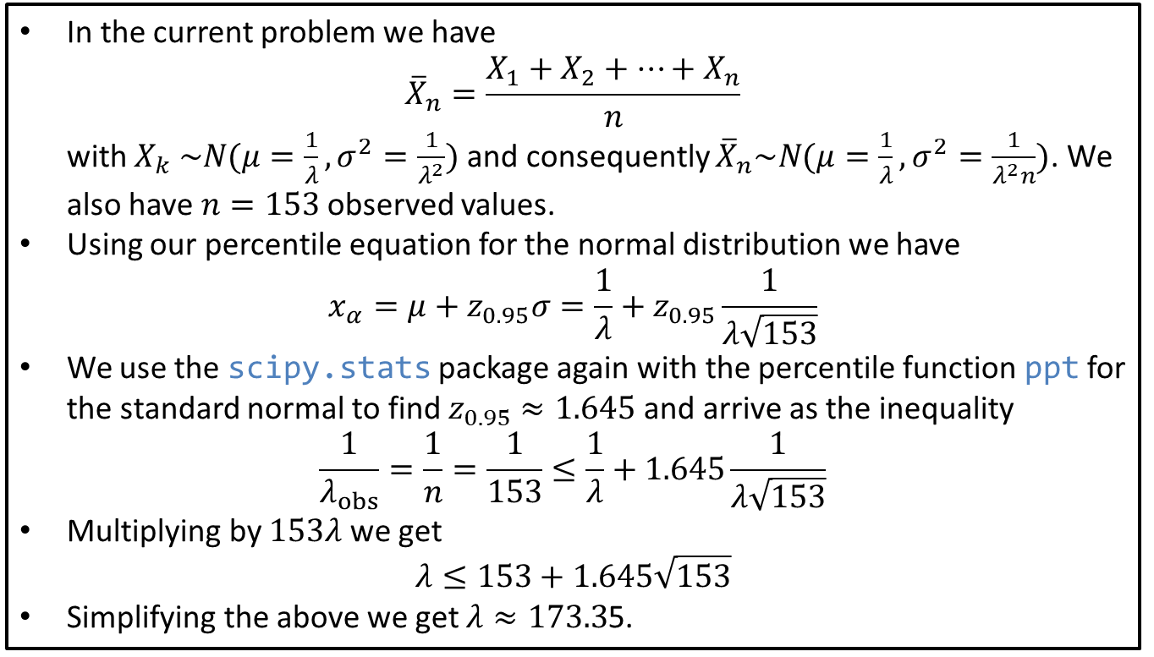

Sensitivity Analysis: $λ=171$.
In the current problem we have ${\overline{X}}_{n}=\frac{X_{1}+X_{2}+…+X_{n}}{n}$ with $X_{k} \sim N(μ=\frac{1}{λ},σ^{2}=\frac{1}{λ^{2}})$ and consequently ${\overline{X}}_{n}\sim N(μ=\frac{1}{λ},σ^{2}=\frac{1}{λ^{2}n})$. We also have $n=153$ observed values.
Using our percentile equation for the normal distribution we have $x_{α}=μ+z_{0.95}σ=\frac{1}{λ}+z_{0.95}\frac{1}{λ\sqrt{153}}$
We use the scipy.stats package again with the percentile function ppt for the standard normal to find $z_{0.95}≈1.645$ and arrive as the inequality
$$\frac{1}{λ_{obs}}=\frac{1}{n}=\frac{1}{153}≤\frac{1}{λ}+1.645\frac{1}{λ\sqrt{153}}$$
Multiplying by $153λ$ we get $λ≤153+1.645\sqrt{153}$
Simplifying the above we get $λ≈173.3$5.
Notes:
See python file section1-1pig.py

Slide 14
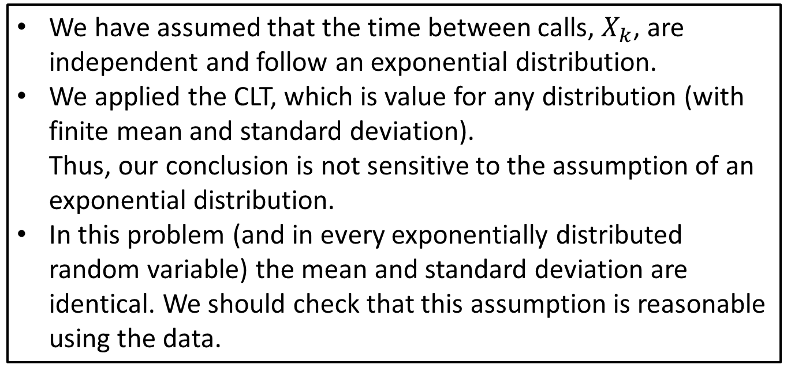
Robustness
We have assumed that the time between calls, $X_{k}$, are independent and follow an exponential distribution.
We applied the CLT, which is value for any distribution (with finite mean and standard deviation). Thus, our conclusion is not sensitive to the assumption of an exponential distribution.
In this problem (and in every exponentially distributed random variable) the mean and standard deviation are identical. We should check that this assumption is reasonable using the data.

